Slide 1
3.1 A review of sets

Slide 2
Introduction
In this topic, we will
Define a set
Define a subset
Define the term disjoint
Give examples of each of these

Slide 3
Sets
Definition:
A set is a collection of unique objects.
For example,
The set of all nanotechnology engineering students in 1A
The set of all people taller than 3 m
The set of all 2-dimensional vectors R²
The set of vectors

Slide 4
Sets
If we are listing the items in a set,
list them between curly braces
All of these vectors will come from the same vector space
The set with no objects is denoted with {}
Initially, however, we will refer to entire vector spaces as a set
All the vectors in R⁶ are unique and form a set
The set of all polynomials in x with real coefficients: R[x]

Slide 5
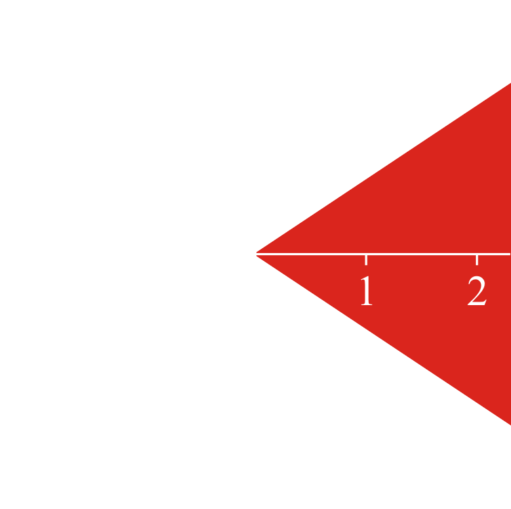
Sets
Sometimes, we will define sets through a description:
The set of all 3-dimensional complex vectors where each entry has an absolute value |z| < 1
Sometimes it will be through an image:

Slide 6
Discrete signals
I may have a description as follows:
The set of all discrete signals that are bounded
That is, the values never exceed some fixed value in absolute value
Note that the zero vector for discrete signals is bounded:

Slide 7
Discrete signals
We may denote a set by an italicized capital Latin letter:
The set S of all students at the University of Waterloo
The set T of all graduates of secondary schools in Ontario
The set U of all complex numbers |z| ≤ 1
The set W of all 3-dimensional vectors with all non-negative entries
If we are discussing an arbitrary vector space,
we may use a script U or V

Slide 8
Subsets
Given two real numbers α and β, the relationship α ≤ β may or may not be true for two such values
The relation tells us how the two values may be related to each other
Definition
One set S is said to be a subset of another set T if every element in S is also in T
This is written as
Note that for all real numbers α ≤ β, at least one of α ≤ β or β ≤ α must be true
However, it may be that and

Slide 9
Subsets
Examples include:
Given the real numbers
All positive real numbers
All integers
All integer multiples of π
Given all students at Waterloo
All nanotechnology engineering students
All students who pass this course
Given all students who graduated from Ontario secondary schools
All students here are not a subset of this larger set

Slide 10
Subsets
In this course, we will always be speaking of subsets of a given vector space
We may then ask if and how two subsets are related
Generally, subsets will be described with a formula
All linear combinations of the two vectors
All vectors of the form where α is any real value

Slide 11
Disjoint subsets
If two subsets of a given set have no entries in common, we will say that those two subsets are disjoint
For example,
The irrational numbers and the integers are disjoint subsets of the real numbers
Given a vector space V, if two subsets both contain the zero vector 0, then those subsets are not disjoint

Slide 12
Summary
Following this topic, you now
Understand the definition of a set
Understand the definition of a subset and disjoint
Are aware of how these will be used in this class

Slide 13
References
[1] https://en.wikipedia.org/wiki/Set_(mathematics)
[2] https://en.wikipedia.org/wiki/Subset

Slide 14
Acknowledgments
Tina Hanna for pointing out an error in a slide.
Mac Qiu for pointing out I used “parentheses” when I meant “braces.”

Slide 15
Colophon
These slides were prepared using the Cambria typeface. Mathematical equations use Times New Roman, and source code is presented using Consolas.
The photographs of flowers and a monarch butter appearing on the title slide and accenting the top of each other slide were taken at the Royal Botanical Gardens in October of 2017 by Douglas Wilhelm Harder. Please see
https://www.rbg.ca/
for more information.

Slide 16
Disclaimer
These slides are provided for the ne 112 Linear algebra for nanotechnology engineering course taught at the University of Waterloo. The material in it reflects the authors’ best judgment in light of the information available to them at the time of preparation. Any reliance on these course slides by any party for any other purpose are the responsibility of such parties. The authors accept no responsibility for damages, if any, suffered by any party as a result of decisions made or actions based on these course slides for any other purpose than that for which it was intended.

